Slide 1


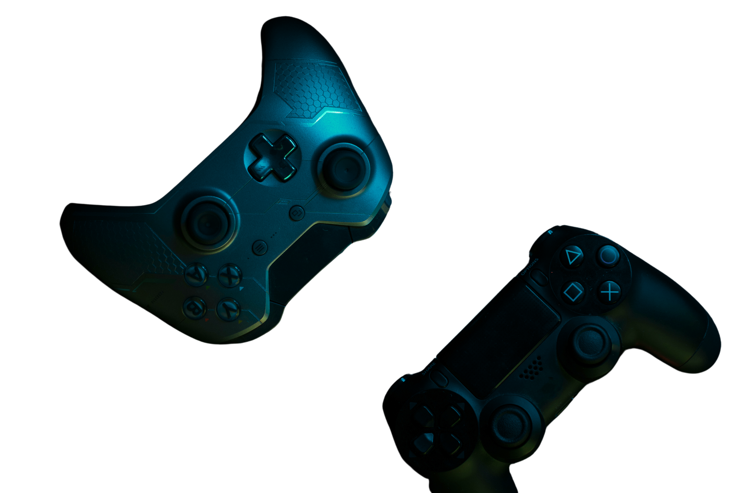
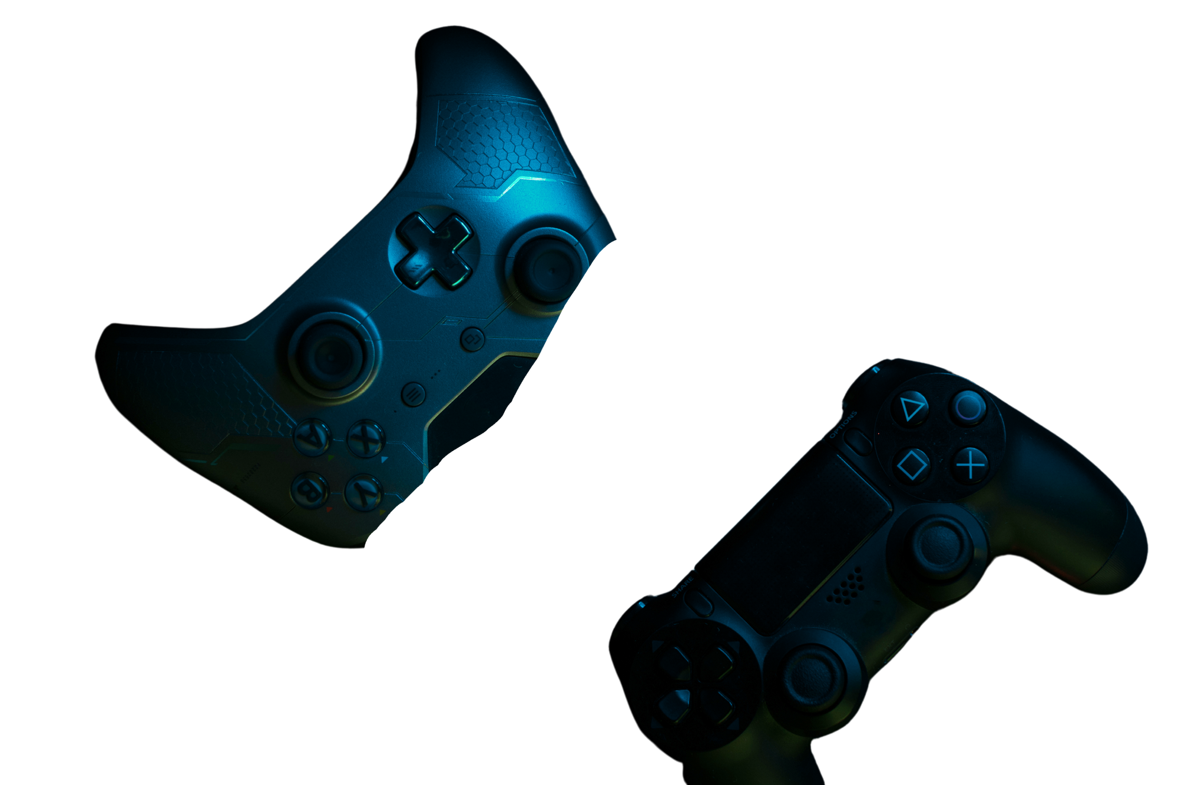
Deep Learning Models On Fashion-MNIST
A Comparative Study of ANN, CNN, U-Net, and VIT
Presented By: SHEHRYAR SHEHRYAR Student ID: P2952028 Course: Neural System Date: 17/October/2025

Slide 2
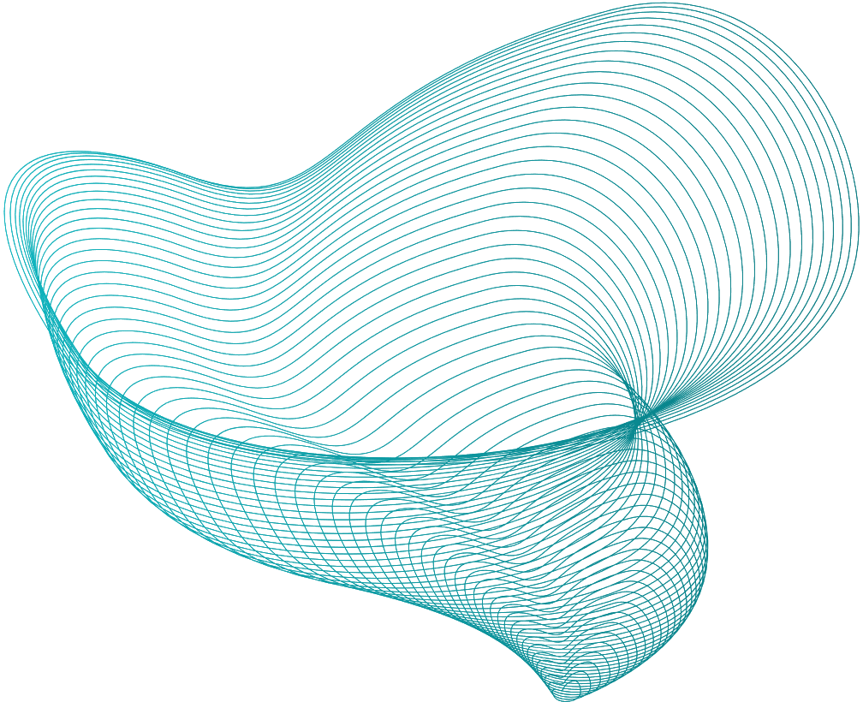
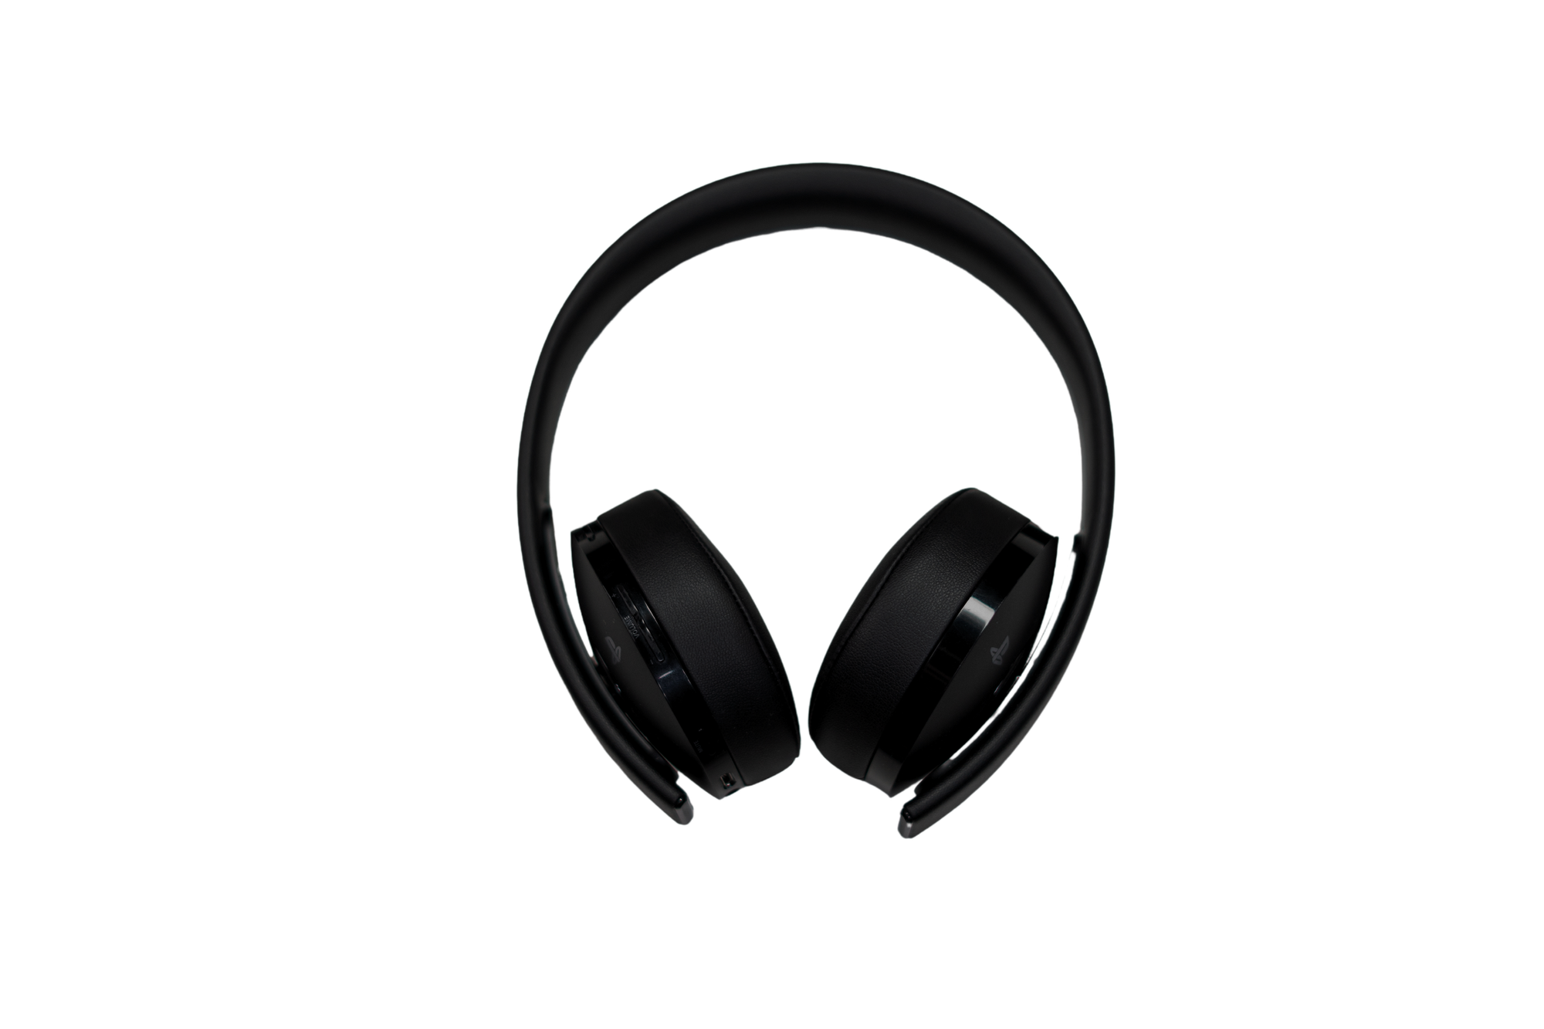
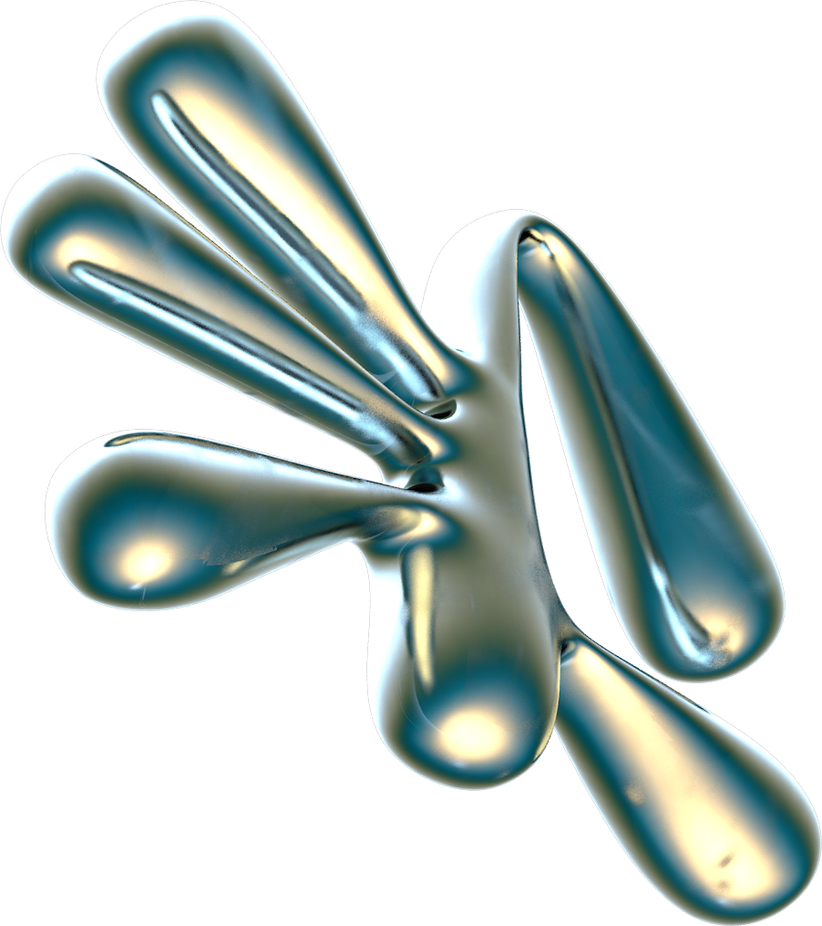
TABLE OF CONTENTS
01.
02.
03.
04.
05.
Introduction
Objectives / Goals
Methodology
DATA/MATERIALS
Implementation
06.
07.
08.
09.
10.
Results
Discussion
Conclusion/Summary
Future Work
Reference

Slide 3


INTRODUCTION
Transforming simple pixels into smart fashion insights

Slide 4
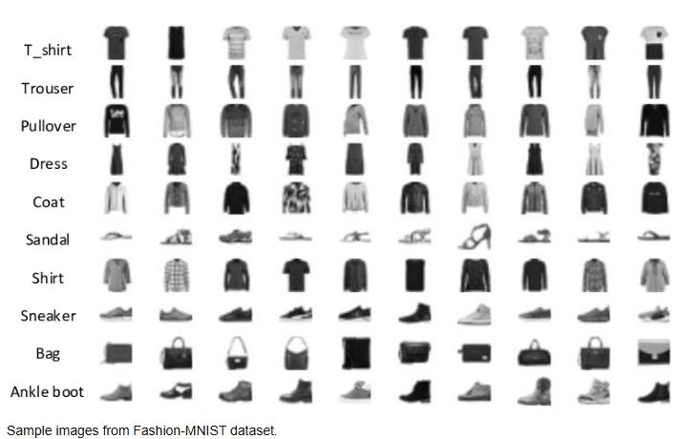
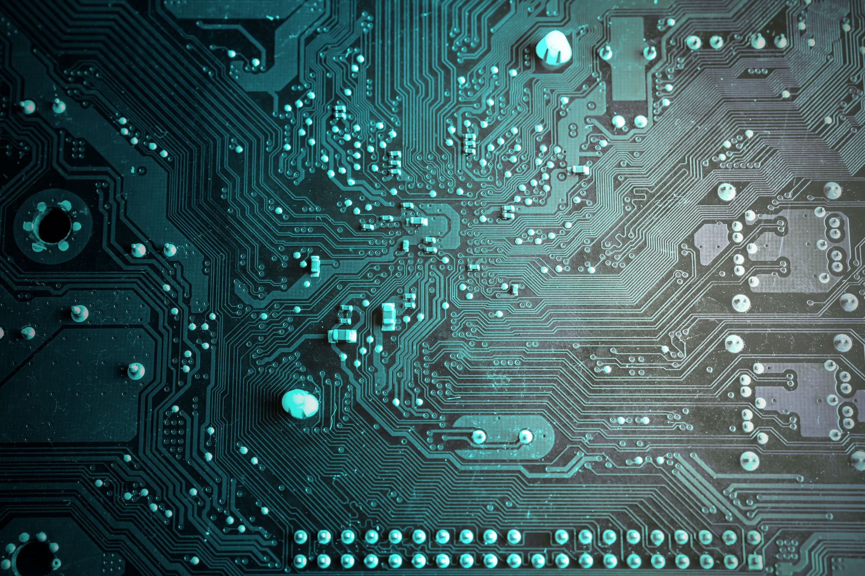
INTRODUCTION:
This project explores deep learning models trained on the Fashion-MNIST dataset.
The topic was chosen to compare ANN, CNN, U-Net, and Vision Transformer.
The aim is to understand their performance differences and visualization ability.
To connect learning with real practice and train models that can understand fashion images like humans.

Slide 5

Objectives/ Goals
Compare ANN, CNN, U-Net & ViT performance.

Slide 6
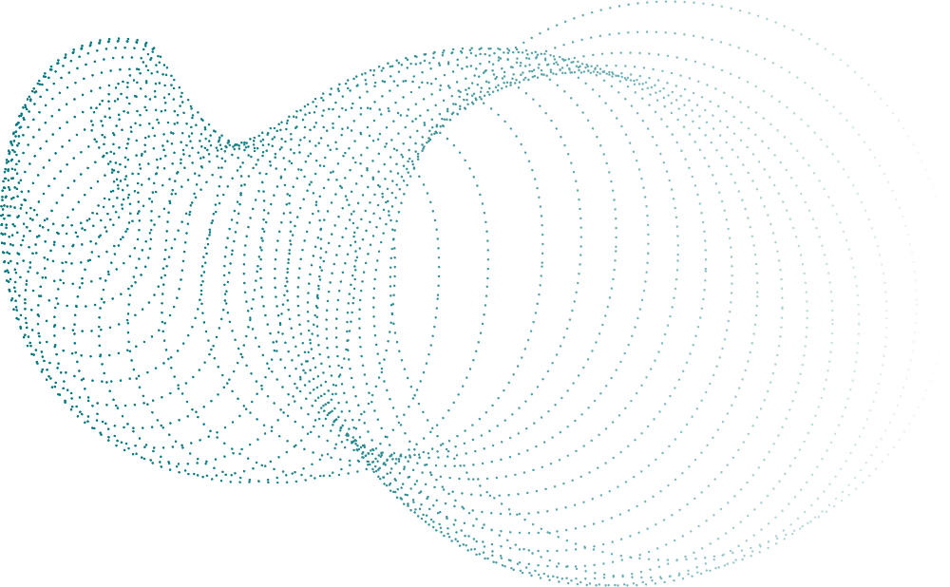
Objectives / Goals
Implement multiple neural architectures on Fashion-MNIST.
Compare classification and segmentation accuracy.
Analyze feature extraction through Vision Transformer.
Evaluate strengths and limitations of each approach.
Compare ANN, CNN, U-Net & ViT performance.
Understand how each model learns images

Slide 7
Methodology / Approach
Train, test, and compare models

Slide 8
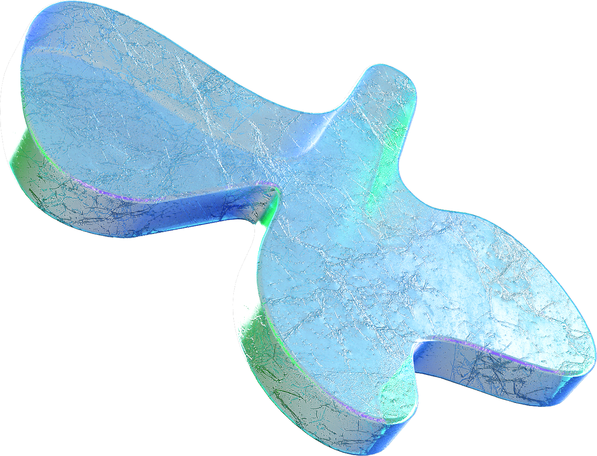

Methodology / Approach
Implemented using PyTorch deep learning framework.
ANN: Fully connected feedforward model.
3. CNN: Convolutional architecture for image recognition.
4. U-Net: Encoder-decoder design for segmentation tasks.
5. Vision Transformer (ViT): Attention-based image model.

Slide 9
Data / Materials / Inputs
Fashion-MNIST dataset for model training and testing

Slide 10
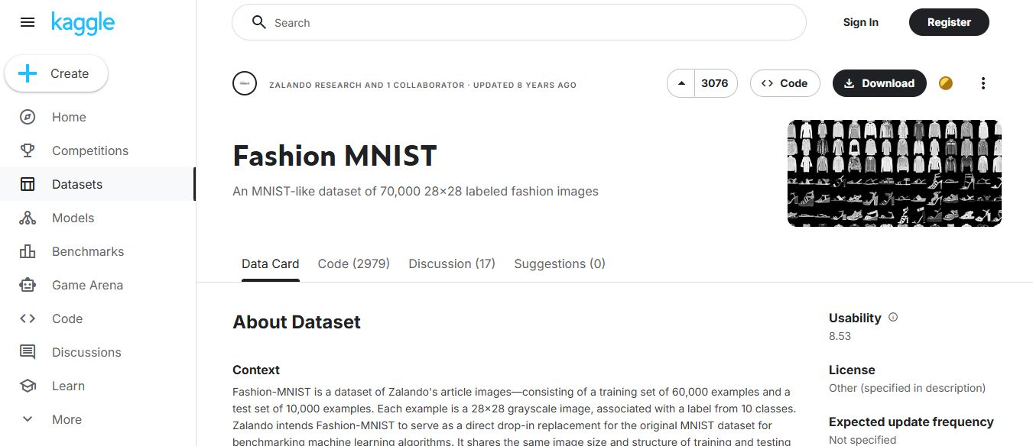
Data /Material /Input
Dataset: Fashion-MNIST consisting of 28×28 grayscale
images representing 10 clothing categories.
Tools & Libraries: Python, PyTorch for deep learning
model development, Matplotlib for visualization, and
NumPy for numerical computations.
Preprocessing: The dataset is normalized to ensure consistent pixel intensity distribution and converted into tensors for PyTorch-based training.
Assumption: The dataset is balanced with uniform image dimensions across all samples, ensuring fair training and evaluation.Source: The dataset was taken from Kaggle for experimentation and model training purposes.

Slide 11
Implementation / Process
The dataset was loaded from Kaggle, preprocessed, and used to train and test the model in PyTorch.

Slide 12
Implementation / Process
Loaded the Fashion-MNIST dataset
Preprocessed images by normalizing pixel values and converting them to tensors.
Split the data into training and testing sets.
Built and trained the model (ANN/CNN) using PyTorch.
Evaluated the model with accuracy metrics and confusion matrix.
Relevant code snapshots are attached to illustrate each step.

Slide 13
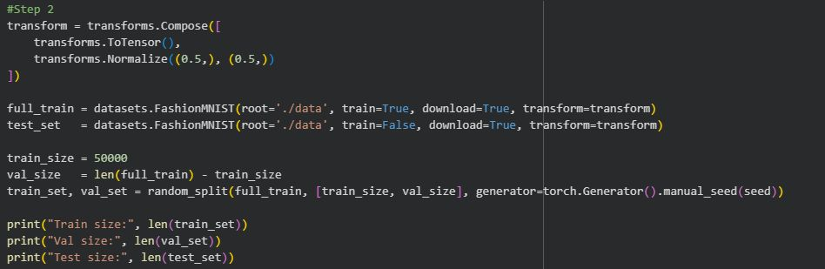
CODE:
Image#1: Data Loading & Preprocessing

Slide 14
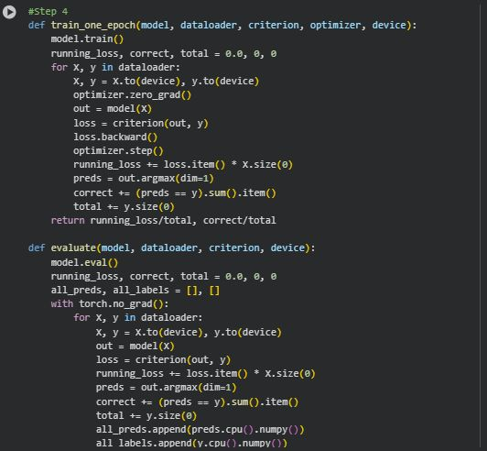
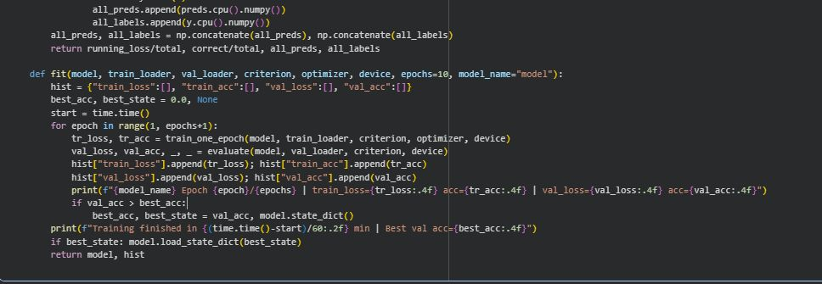
Image#2 & 3: TRAINING

Slide 15
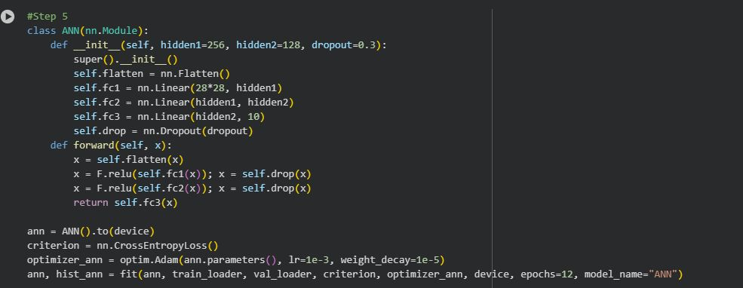
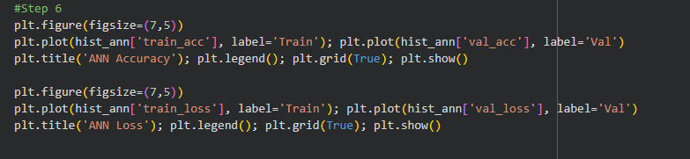
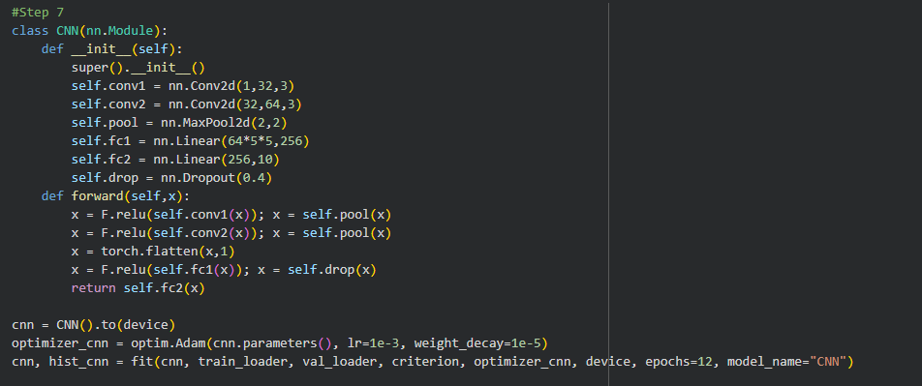
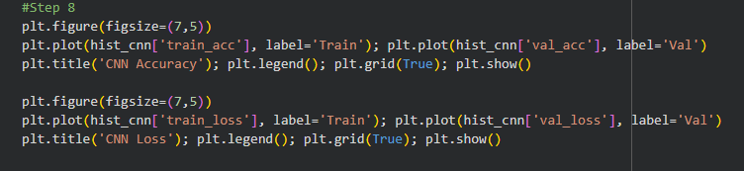
ANN Visualization
CNN Model
ANN Model
Image # 4 & 5 & 6 & 7: CNN Visualization

Slide 16
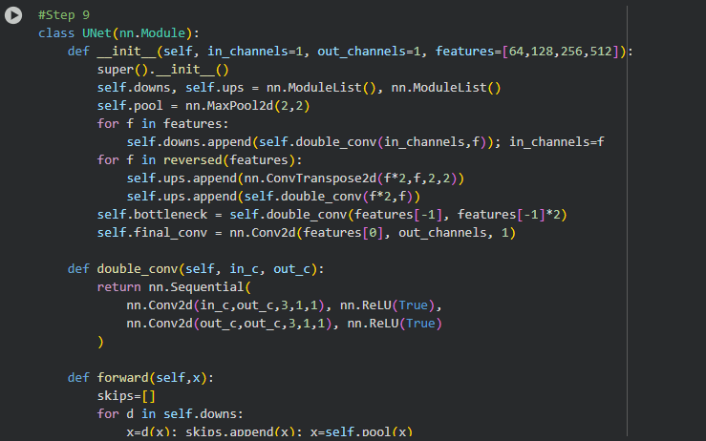
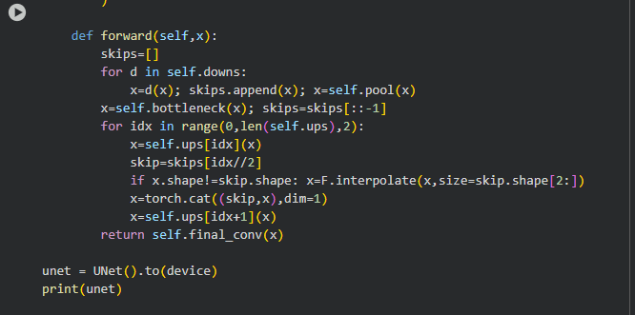
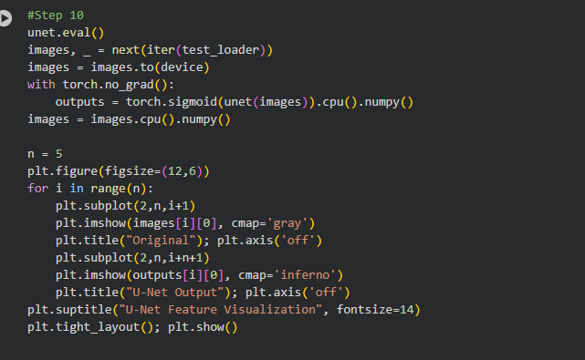
U-Net Model
U-Net Model
Image # 8 & 9 & 10: U-Net Visualization

Slide 17
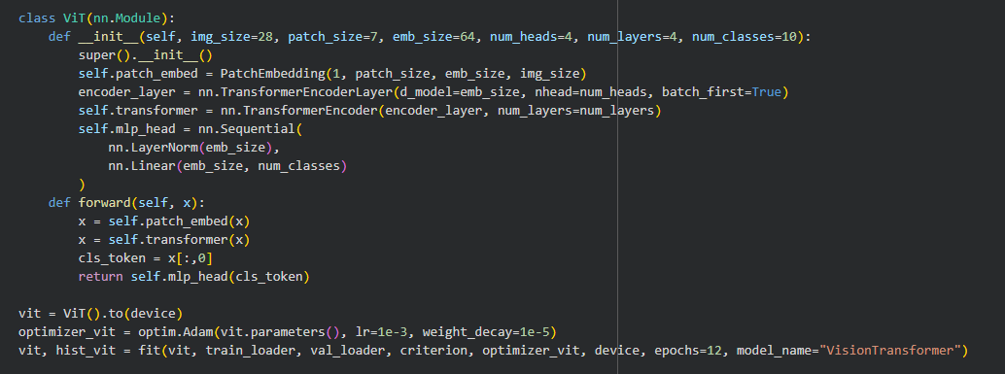
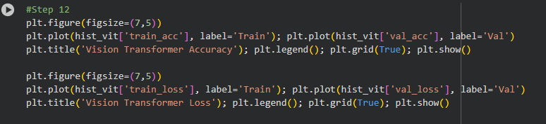
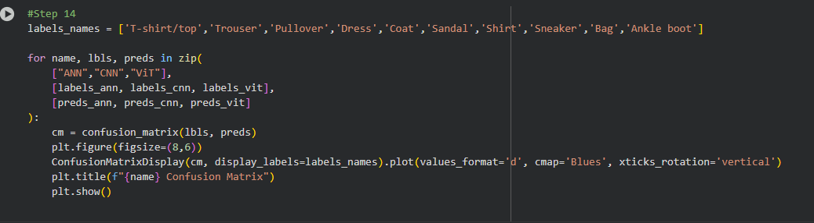
Vision Transformer and Graph
Image # 11 & 12 & 13: Confusion Matrix

Slide 18
Results / Findings
NN accurately classified Fashion-MNIST images with high performance

Slide 19
Results / Findings
ANN achieved ~85% accuracy.
CNN achieved ~92% accuracy with strong feature detection.
U-Net provided good feature segmentation visualizations.
Vision Transformer achieved ~93% accuracy using self-attention.

Slide 20
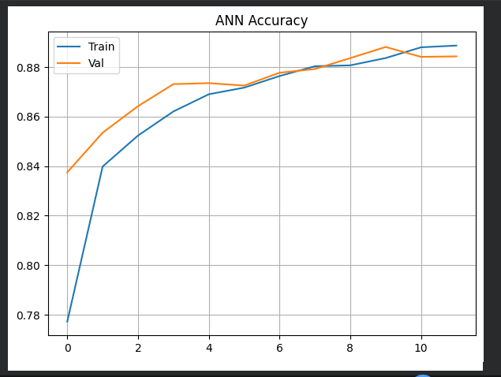
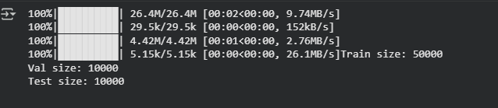
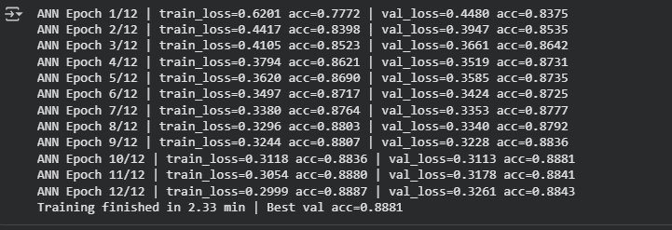
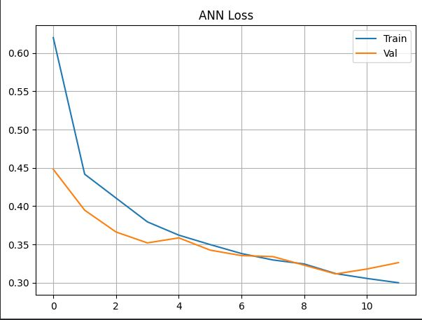
Output:
Download Data
ANN Output
Graph ANN

Slide 21
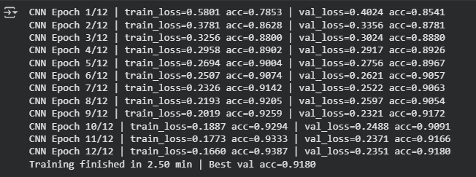
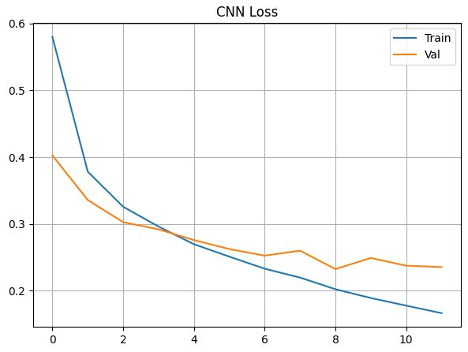
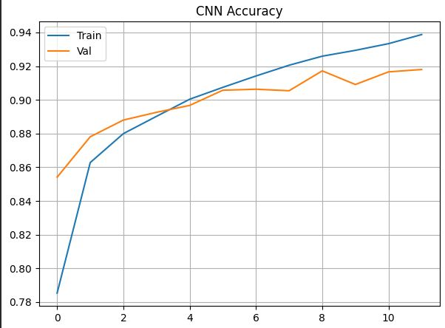
CNN Output & Graph

Slide 22
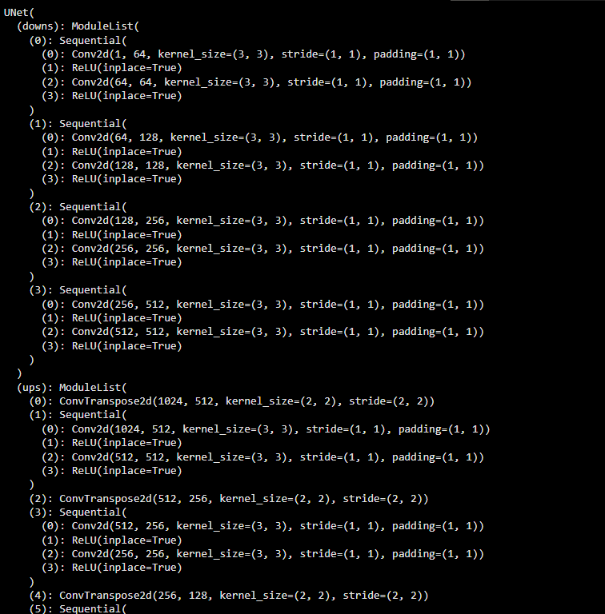
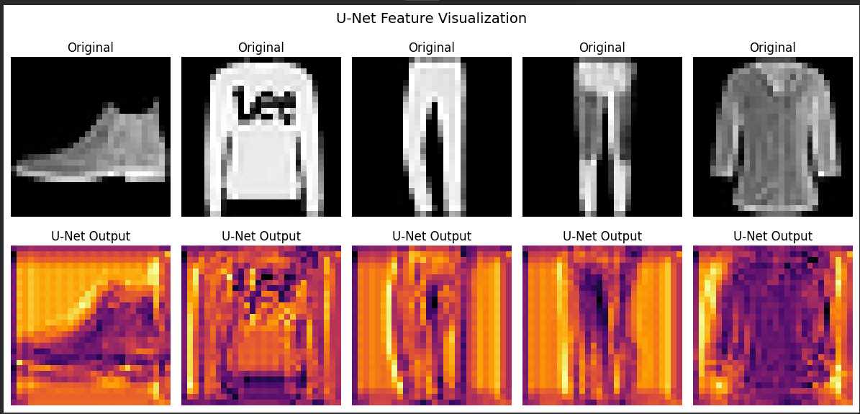
U-Net Output & Visualization

Slide 23
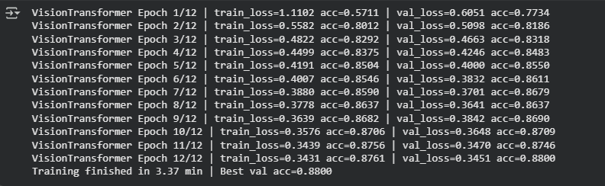
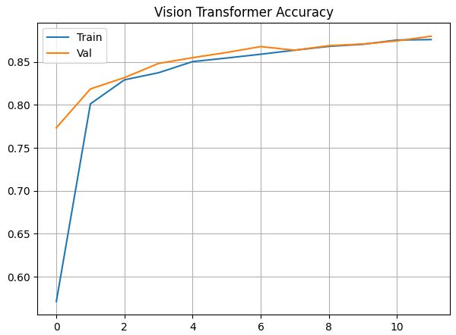
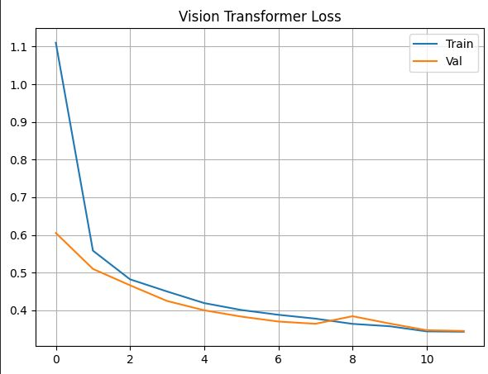
ViT Output & Graph

Slide 24
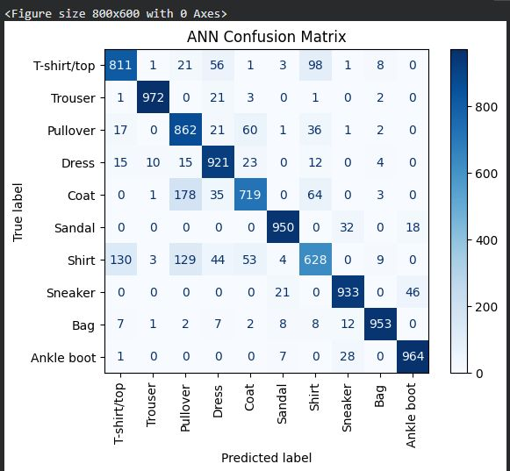
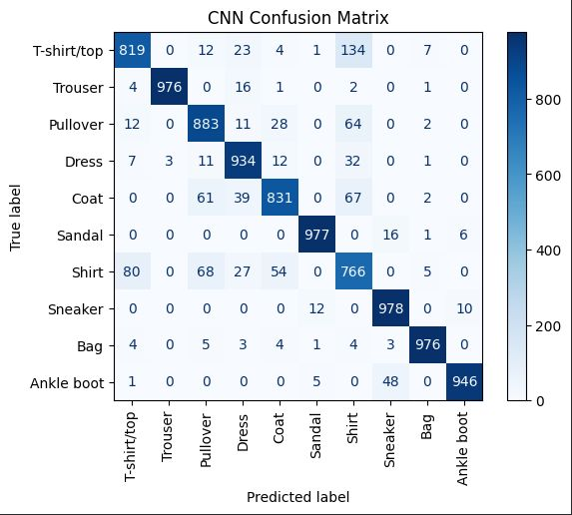
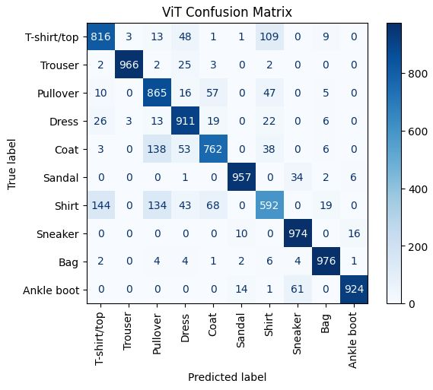
Confusion Matrix ANN, CNN, ViT

Slide 25
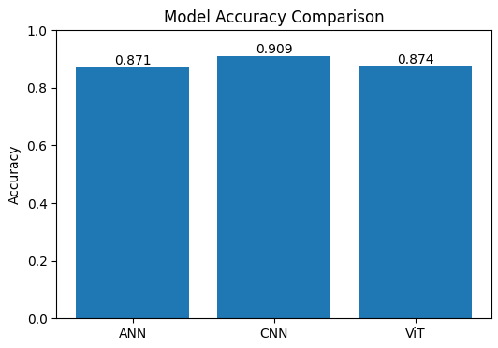
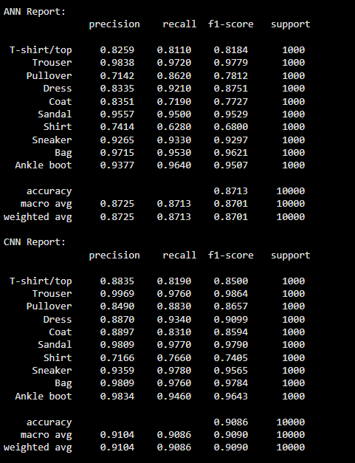
Comparison Graph & Output

Slide 26
Discussion / Interpretation

Slide 27
Discussion / Interpretation
CNN and ViT models showed superior classification results.
U-Net revealed spatial feature learning patterns.
Transformers are efficient on image patches even with limited data.
Challenges: long training time and GPU memory constraints.

Slide 28
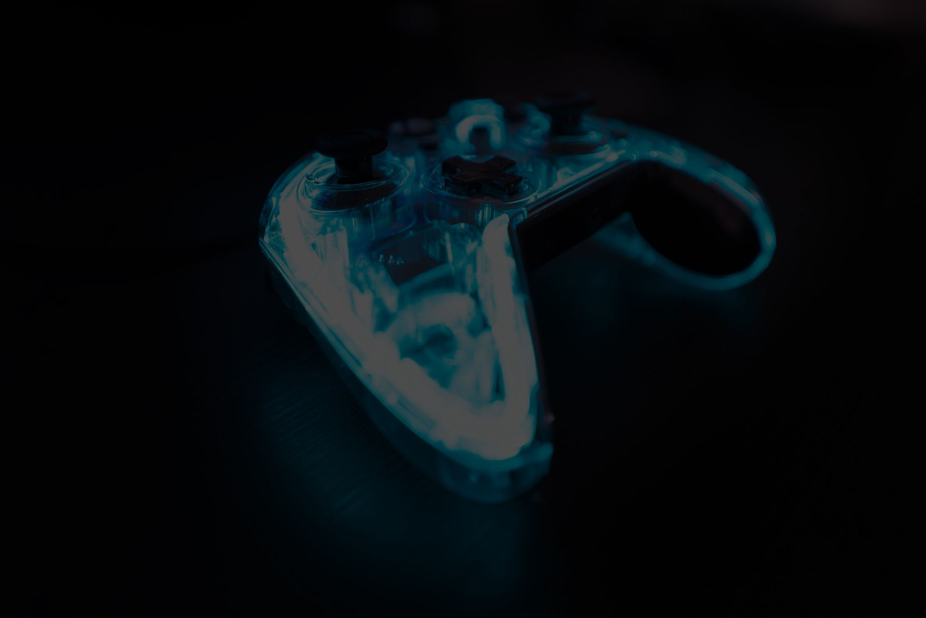
Future Work / Acknowledgments

Slide 29
Future Work / Acknowledgments
Future Work: Apply models to larger datasets like CIFAR-10 or ImageNet.
Optimize training using data augmentation and schedulers.
Acknowledgments: De Montfort University, PyTorch documentation, OpenAI GPT assistance.

Slide 30
Reference:
Paszke, A., Gross, S., Massa, F., et al. (2019). PyTorch: An Imperative Style, High-Performance Deep Learning Library. https://pytorch.org/docs/stable/index.html
Goodfellow, I., Bengio, Y., & Courville, A. (2016). Deep Learning. MIT Press. http://www.deeplearningbook.org
Hunter, J. D. (2007). Matplotlib: A 2D Graphics Environment. Computing in Science & Engineering, 9(3), 90–95. https://matplotlib.org
Xiao, H., Rasul, K., & Vollgraf, R. (2017). Fashion-MNIST: a Novel Image Dataset for Benchmarking Machine Learning Algorithms. Kaggle

